Slide 1


Machine learning based visual style advisor for personalized fashion and beauty recommendations
24-25J-155
Proposal Presentation
8/10/2024

Slide 2
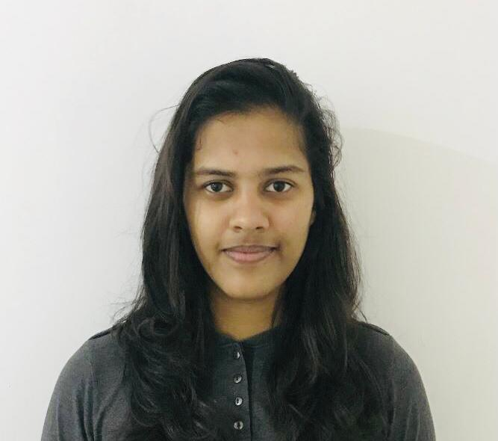


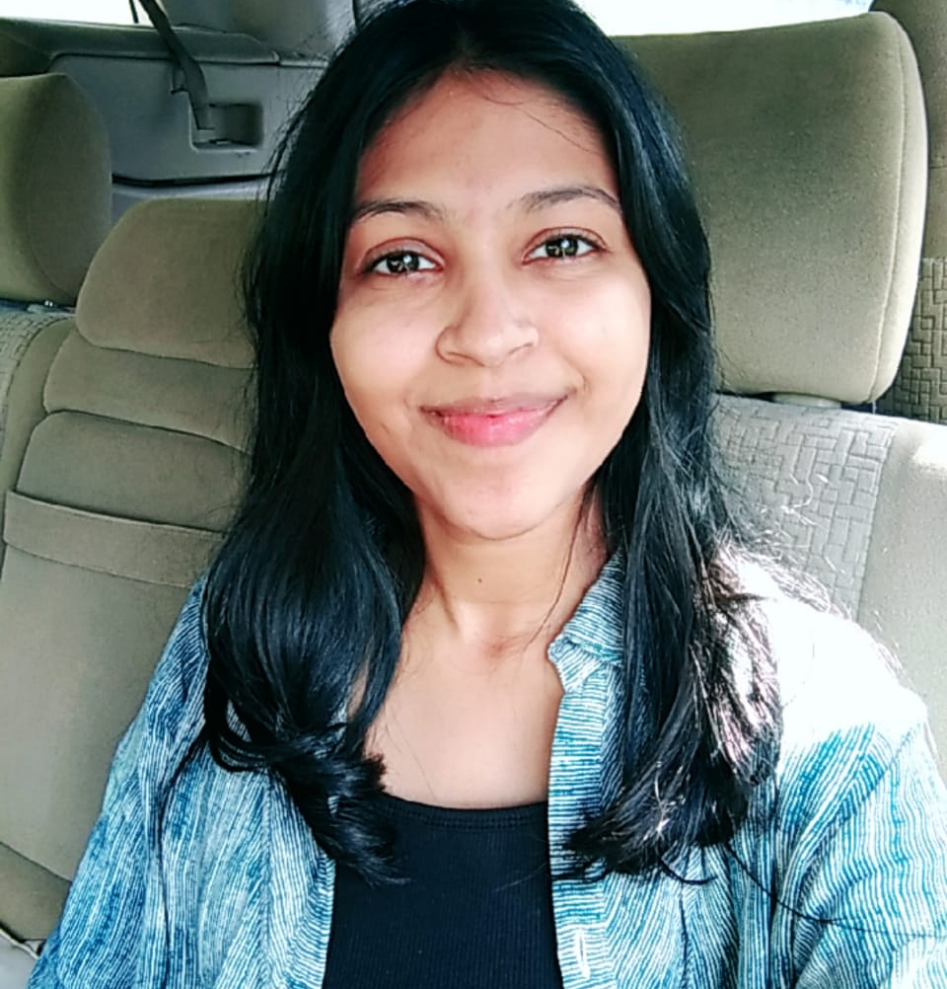

Meet Our Team !
Prasadi S.A.D.T.
IT21894824
Shaakir J.H.M.
IT21322280
Vikasitha M.K.I.
IT21180798
Senarathne D.R.
IT21213144
8/10/2024

Slide 3
INTRODUCTION
In an era where personalization is key to enhancing user experience.
The integration of machine learning into fashion and beauty has paved the way for tailored recommendations that cater to individual preferences.
This project, "Machine Learning Based Visual Style Advisor," leverages advanced techniques such as hair style and color simulation, virtual fit-on for clothing, and skin tone identification.
The goal is to offer personalized fashion and beauty advice.
By combining these elements, the system provides users with a comprehensive and interactive platform.
The platform enhances their personal style with precision and ease.
8/10/2024

Slide 4
RESEARCH QUESTION
How can machine learning enhance the personalization of hair color and hairstyle simulations to align with individual preferences and facial features?
What impact does real-time virtual fit-on technology have on user satisfaction and confidence in clothing recommendations?
In what ways can skin tone identification and makeup recommendation algorithms be optimized to provide more accurate and holistic beauty suggestions?
How do current recommendation systems fall short in integrating comprehensive hair color and style advice, and how can these limitations be addressed through advanced AI techniques?
What role do trends and peer influence play in young individuals' decision-making processes, and how can personalized guidance counterbalance these external pressures?
8/10/2024

Slide 5
OBJECTIVES
Main Objective
Sub Objectives
To develop a highly effective machine learning based personalized fashion and beauty recommendation system for the young generation. This system aims to address the current challenges individuals face when selecting hairstyles, hair colors and skin tone identification & makeup without personalized guidance. And also, to develop a clothing recommendation tool with virtual fit-on with enhanced features.
Hair Style Transformation and Realistic Simulation for Personalized Recommendations
Personalized Hair Color Recommendation Using Deep Learning
Clothing Recommendation with Virtual Fit-On
Skin Tone Identification and Makeup
Recommendations
8/10/2024

Slide 6
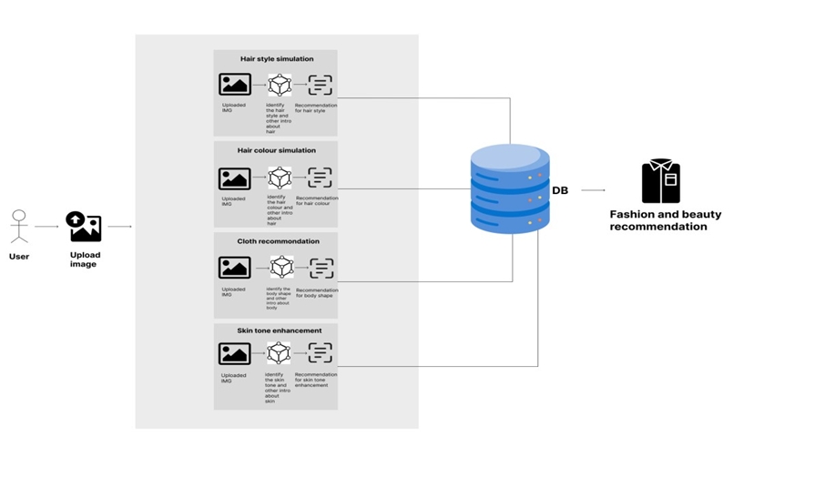
System Diagram
8/10/2024

Slide 7
IT21894824 | Prasadi S.A.D.T.
Specialization : Information Technology
IT21894824 | Prasadi S.A.D.T. | 24-25J-155
8/10/2024

Slide 8
Personalized Hair Color Recommendation Using Deep Learning
IT21894824 | Prasadi S.A.D.T. | 24-25J-155
8/10/2024

Slide 9
Introduction
Background
The rise of deep learning and image processing technology has enabled the development of personalized hair color recommendation systems, allowing users to visualize potential hair color changes in real-time based on their unique features.
Many hair color recommendation systems utilize machine learning models, particularly convolutional neural networks (CNNs), to analyze individual traits such as skin tone, eye color, and natural hair color, providing tailored suggestions that enhance user satisfaction.
Traditional hair color selection tools often limit users to predefined palettes with minimal customization. In contrast, modern systems offer more in-depth personalization, considering lifestyle factors, preferences, and professional feedback to suggest hair colors that are uniquely suited to each user.
IT21894824 | Prasadi S.A.D.T. | 24-25J-155
8/10/2024

Slide 10
Introduction
Research Gap
Existing systems do not adequately combine various personal features (e.g., skin tone, eye color, lifestyle) to provide truly personalized hair color recommendations.
Many current systems do not fully utilize advanced deep learning models like CNNs for feature extraction and classification, which limits the accuracy of their recommendations.
Current systems rarely offer interactive visualization of recommended hair colors, which would allow users to see and adjust colors in real-time, enhancing user engagement and satisfaction.
IT21894824 | Prasadi S.A.D.T. | 24-25J-155
8/10/2024

Slide 11


Introduction
Research Gap
Research | Deep Learning for Feature Extraction | Personalization | Real-Time Visualization | User Feedback Integration | Scalability
Research A
Research B
Research C
Proposed System

Slide 12
How can deep learning techniques be leveraged to develop a personalized hair color recommendation system that accurately integrates individual features such as skin tone, eye color, natural hair color, and lifestyle preferences, while offering interactive visualization tools for enhanced user engagement and satisfaction?
Research Problem
IT21894824 | Prasadi S.A.D.T. | 24-25J-155
8/10/2024

Slide 13
Specific and Sub Objective
Sub Objectives
Specific Objective
Implement data augmentation techniques to improve model generalization and normalize data for consistent input to CNN models.
Use transfer learning by fine-tuning pre-trained CNN models for specific attributes like skin tone and hair condition.
Create an intuitive front-end interface that allows users to upload images, input preferences, and interact with the recommended hair color palette.
Set up a robust backend infrastructure for processing images, running model inference, and integrating user data with the recommendation system.
Optimize the system for real-time processing and ensure it can scale effectively to support an increasing number of users while maintaining performance.
Personalized Hair Color Recommendation Using Deep Learning
IT21894824 | Prasadi S.A.D.T. | 24-25J-155
8/10/2024

Slide 14
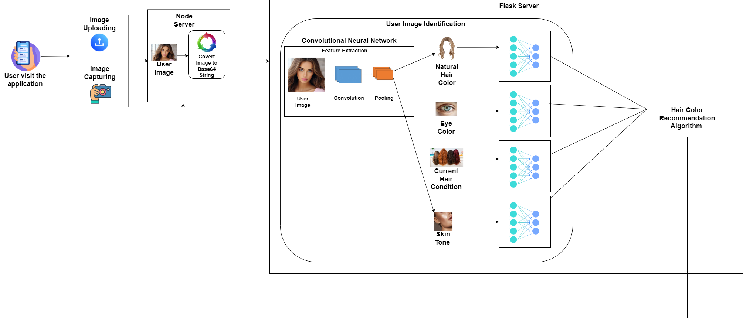
Methodology
System Diagram
IT21894824 | Prasadi S.A.D.T. | 24-25J-155
8/10/2024

Slide 15
Technologies, Tools & Algorithms
Algorithms & Architectures
Technologies
Tools
React Native
Expo
Python
Tensorflow
MongoDB
Node
Google Colab
GitHub
Docker
VS Code
Kaggle
Hugging Face
CNN
Microservices Architecture
NLP
Image Processing
ResNet
IT21894824 | Prasadi S.A.D.T. | 24-25J-155
8/10/2024

Slide 16
System, personal, and software Requirements specification
System Requirements
Operating Systems - The system must be compatible with Android and iOS operating systems.
Web Browsers - The system should be accessible through modern web browsers such as Google Chrome, Safari, and Firefox, ensuring compatibility with the latest versions of these browsers.
Internet Connection - The mobile app requires a stable internet connection to upload images, process data, and interact with the recommendation system in real-time.
IT21894824 | Prasadi S.A.D.T. | 24-25J-155
8/10/2024

Slide 17
Personal Requirements
Basic Photography Skills - Users should have the ability to take clear, well-lit photos of themselves using their mobile device, as the app relies on image quality for accurate feature extraction and recommendations.
Attention to Detail - Users should be attentive and precise when inputting personal details such as current hair condition, lifestyle preferences, and other relevant information, as these inputs significantly impact the accuracy of the recommendations.
Interest in Personal Style and Fashion - Users should have an interest in exploring new hair colors and styles, as the app is designed to help users experiment with and choose looks that enhance their personal style.

Slide 18
Software Specific Requirements
React Native
Python
Tensorflow
MongoDB
Node

Slide 19
Functional Requirements
Non-Functional Requirements
Allow users to upload photos and automatically detect features like skin tone, hair color, and eye color using deep learning.
Generate and display tailored hair color suggestions based on detected features and user preferences.
Enable users to apply and see recommended hair colors on their photos in real-time.
Allow users to provide feedback and adjust their preferences to improve future recommendations.
Higher Accuracy Of results.
Should properly work for IOS and Android devices.
Should have high security.
Application should be reliable.
Interfaces should be more user-friendly.

Slide 20
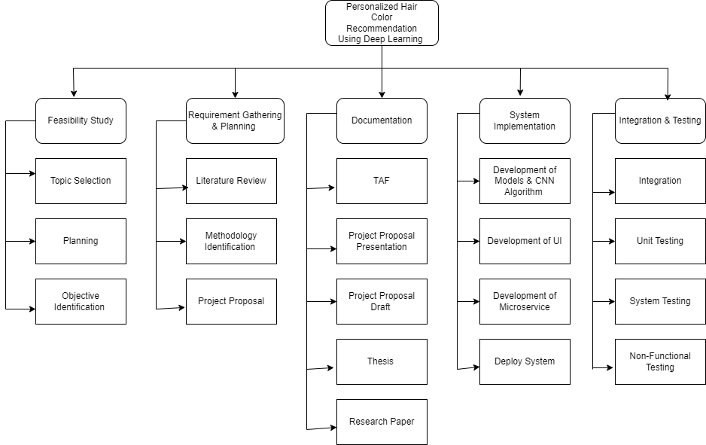
Work Breakdown Structure
IT21894824 | Prasadi S.A.D.T. | 24-25J-155
8/10/2024

Slide 21
References
[1] J. Smith and R. Brown, "A Study on Hair Color Recommendation Systems," IEEE Transactions on Consumer Electronics, vol. 67, no. 2, pp. 34-42, March 2022.
[2] A. Johnson and M. Wang, "Advancements in Personalized Beauty Recommendations Using AI," IEEE Access, vol. 9, pp. 123456-123465, June 2021.
[3] L. Kim and J. Lee, "Deep Learning Applications in Fashion and Beauty Industry," IEEE Transactions on Multimedia, vol. 23, no. 6, pp. 23-34, November 2020
[4] R. Gonzalez, M. Rivera, and S. Park, "AI-Powered Personalization in Beauty Applications," IEEE Intelligent Systems, vol. 36, no. 4, pp. 56-63, July 2021.
[5] P. Nair and D. Kumar, "Real-Time Virtual Hair Color Try-On Using Deep Learning," IEEE Transactions on Image Processing, vol. 30, pp. 1567-1578, January 2021.
IT21894824 | Prasadi S.A.D.T. | 24-25J-155
8/10/2024

Slide 22
IT21322280 | Shaakir J.H.M
Specialization : Software Engineering
IT21322280 | Shaakir J.H.M | 24-25J-155
8/10/2024

Slide 23
Clothing Recommendations with Enhanced Virtual Fit-on Features
IT21322280 | Shaakir J.H.M | 24-25J-155
8/10/2024

Slide 24
INTRODUCTION
IT21322280 | Shaakir J.H.M | 24-25J-155
8/10/2024

Slide 25
Background
The advancement of AR technology has transformed the online shopping experience, allowing users to virtually try on clothes and see how they fit in real-time.
Many clothing recommendation systems have been developed, leveraging machine learning and computer vision to suggest outfits based on user preferences and behavior.
Most platforms offer limited customization, typically restricted to size and color options, without allowing detailed personalization of garment designs and patterns.
IT21322280 | Shaakir J.H.M | 24-25J-155
8/10/2024

Slide 26
Research Gap
Existing systems generally offer limited customization options, primarily focusing on recommending pre-designed garments without allowing users to personalize aspects such as designs, patterns, and colors.
While there is growing awareness of sustainable fashion, existing solutions rarely provide information or guidance on environmentally friendly materials and manufacturing practices.
There is a lack of features that educate users on how to make their clothing choices more sustainable, or how to convert their wardrobe into a more eco-friendly one.
Many virtual try-on platforms lack a social component, which could foster user interaction, sharing, and feedback within a community of fashion enthusiasts.
IT21322280 | Shaakir J.H.M | 24-25J-155
8/10/2024

Slide 27
How can a clothing recommendation system be developed that not only allows users to virtually try on outfits but also provides advanced customization options and comprehensive sustainability insights, while fostering a social environment for user interaction?
Research Problem
IT21322280 | Shaakir J.H.M | 24-25J-155
8/10/2024

Slide 28
Specific & Sub Objectives
Sub Objective
Specific Objective
To incorporate features that provide users with detailed information about the materials used in the apparel, including manufacturing processes and environmental impact.
To suggest tips on how users can make their clothing choices more sustainable and environmentally friendly.
To design the application with social media-like functionalities, allowing users to share their virtual fit-ons, interact with others, and receive real-time feedback, thereby creating a vibrant and engaging community.
To develop a clothing recommendation system with virtual fit-on capabilities using AR technology. To enable users to customize their chosen apparel in real-time by altering designs, patterns, and colors at a granular level
IT21322280 | Shaakir J.H.M | 24-25J-155
8/10/2024

Slide 29
PROPOSED METHODOLOGY
IT21322280 | Shaakir J.H.M | 24-25J-155
8/10/2024

Slide 30
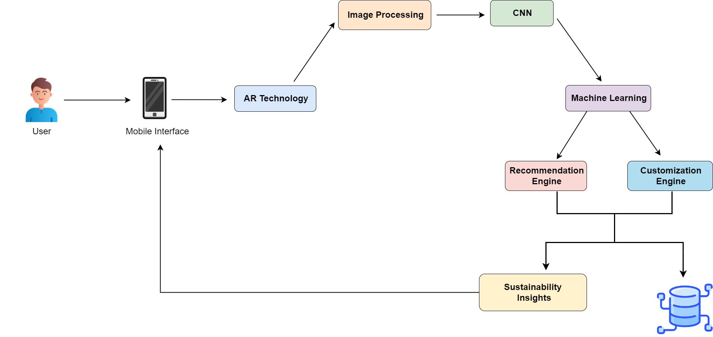
System Overview
IT21322280 | Shaakir J.H.M | 24-25J-155
8/10/2024

Slide 31
Technologies, Tools & Algorithms
Algorithms & Architectures
Technologies
Tools
React Native
Expo
Python
Tensorflow
MongoDB
Node
Google Colab
Kaggle
ARKit / ARCore
GitHub
Docker
VS Code
CNN
Microservices Architecture
Image Processing
NLP
ResNet
IT21322280 | Shaakir J.H.M | 24-25J-155
8/10/2024

Slide 32
Requirements
Functional
Non-Functional
Software
Enable users to try on selected clothes virtually using AR technology. Display detailed information about the materials used, manufacturing processes, and environmental impact of each garment. Provide personalized clothing recommendations based on wardrobe, search history, and user preferences.
Scalability
Performance
Security
Usability
Compatibility
AR Frameworks
3D Modeling Software
Machine Learning Libraries
Development Tools
IT21322280 | Shaakir J.H.M | 24-25J-155
8/10/2024

Slide 33
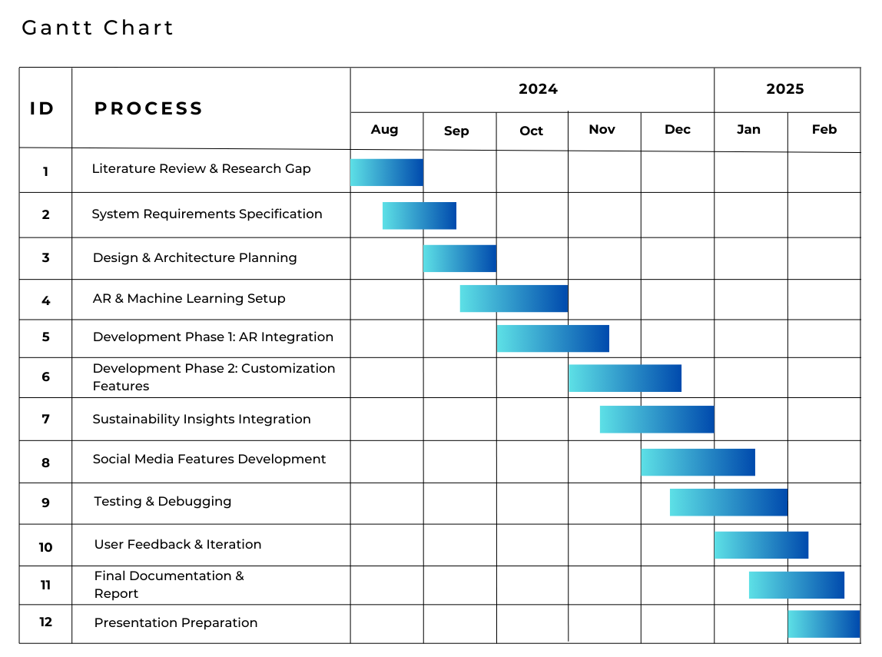
Work Breakdown Structure
IT21322280 | Shaakir J.H.M | 24-25J-155
8/10/2024

Slide 34
References
[1] S. Shete, H. Darshan, M. Thakare and K. Dhuri, "AI based Fashion Stylist Recommendation System," 2024 11th International Conference on Computing for Sustainable Global Development (INDIACom), New Delhi, India, 2024, pp. 697-701, doi: 10.23919/INDIACom61295.2024.10498329.
[2] S. Elsawaf and A. Barbar, "Online Fitting Room: A Mobile Shopping Application using Augmented Reality (AR) Technology," 2023 18th International Joint Symposium on Artificial Intelligence and Natural Language Processing (iSAI-NLP), Bangkok, Thailand, 2023, pp. 1-5, doi: 10.1109/iSAI-NLP60301.2023.10354859.
[3] A. Mishra, S. Kaintura, Y. S. Yadav, V. Joshi, H. Vaidya and A. Kapruwan, "GANs and Augmented Reality in Virtual Clothing Try-On," 2024 International Conference on Intelligent and Innovative Technologies in Computing, Electrical and Electronics (IITCEE), Bangalore, India, 2024, pp. 1-6, doi: 10.1109/IITCEE59897.2024.10467813.
[4] L. Sivaranjani, S. K. Rachamadugu, B. V. S. Reddy, B. R. A, M. Sakthivel and S. Depuru, "Fashion Recommendation System Using Machine Learning," 2023 4th International Conference on Smart Electronics and Communication (ICOSEC), Trichy, India, 2023, pp. 1367-1374, doi: 10.1109/ICOSEC58147.2023.10275967.
IT21322280 | Shaakir J.H.M | 24-25J-155
8/10/2024

Slide 35
IT21180798 | Vikasitha M.K.I.
Specialization: Information Technology
IT21180798 | Vikasitha M.K.I. | 24-25J-155
8/10/2024

Slide 36
Hair Style Transformation and Realistic Simulation for Personalized Recommendations

Slide 37
Introduction
Importance: Offers significant value by providing users with personalized, realistic, and culturally sensitive hair styling options.
Requirement of hairstyle simulator: Traditional systems often deliver generic hairstyle recommendations based on popularity or purchase history, lacking personalized, nuanced suggestions and failing to integrate comprehensive hairstyle advice.
Benefits: Ability to try hairstyles in real-time and choose one that matches the individual's face shape and regional characteristics
IT21180798 | Vikasitha M.K.I. | 24-25J-155
8/10/2024

Slide 38
Background
Human races are traditionally categorized into groups like Caucasian/White, Mongoloid/Asian, Negroid/Black, and Australoid, though these distinctions are considered social constructs rather than biologically distinct groups. [1]
Hairstyles vary widely across cultures and eras, serving as expressions of identity, influenced by factors such as social status, ethnicity, fashion trends, and personal taste. [2]
Barbers traditionally identify suitable hairstyles for individuals based on face shapes—such as oval, round, square, heart, and diamond, using experience and knowledge passed down through practice. [3]
IT21180798 | Vikasitha M.K.I. | 24-25J-155
8/10/2024

Slide 39


Research Gap
Research | Identify the person based on the region | Realtime Identify face shape of the person | Suggest best hairstyles based on the region and the face shape | Simulator to try identified hairstyles in real-time. | Ability to try hairstyles which are belong to other regions based on the face shape.
Research A
Research B
Research C
Research D
Proposed System
IT21180798 | Vikasitha M.K.I. | 24-25J-155
8/10/2024

Slide 40
When and where to use image processing while detecting the person’s region?
How many resources and machine learning or deep learning models are required to identify the region and face shapes?
What are the technologies required to present real-time hairstyles that match the face shape?
How to develop and implement deep learning models running in optimal conditions with minimal resource components
Research Problem
IT21180798 | Vikasitha M.K.I. | 24-25J-155
10/08/2024

Slide 41
Specific and Sub Objective
Sub Objectives
Specific Objective
Identify human race by using image classification.
Face shape detection model
Male hairstyle suggestion
Female hairstyle suggestion
Generate appropriate hairstyle for user using Generative Adversarial Network
Hair Style Transformation and Realistic Simulation for Personalized Recommendations
IT21180798 | Vikasitha M.K.I. | 24-25J-155
8/10/2024

Slide 42
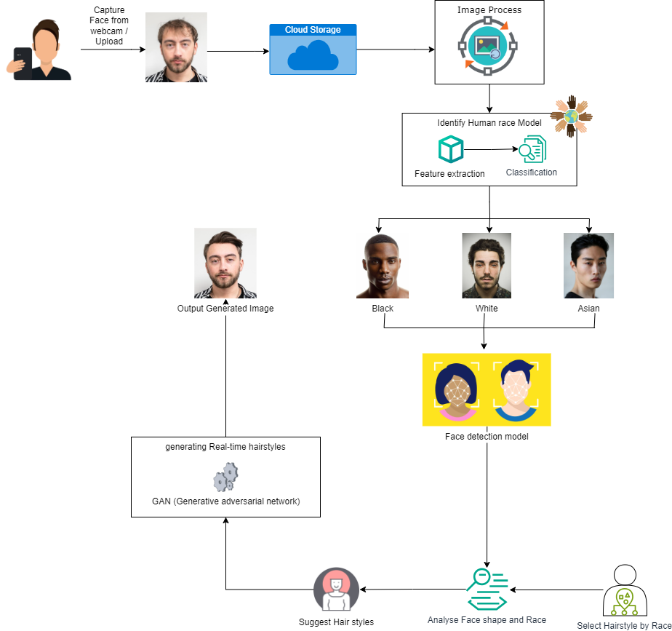
Methodology
System Diagram
IT21180798 | Vikasitha M.K.I. | 24-25J-155
8/10/2024

Slide 43
Technologies, Tools & Algorithms
Techniques & Infrastructure
Algorithms & Architectures
Technologies
Python
JavaScript
TensorFlow
OpenCV
React Native
React
Image Processing
Data Analytics
Cloud(Aws , Docker)
Version Control (Git)
Google Colab
Kaggle
CNN
Support Vector Machine (SVM)
VGG16
ResNet
IT21180798 | Vikasitha M.K.I. | 24-25J-155
8/10/2024

Slide 44
Personal Requirement
Functional Requirement
Non - Functional Requirement
User Profiles should store personal preferences, face shape information, and hairstyle history.
The system should accurately detect and classify face shapes using image processing techniques.
Based on detected face shape and regional characteristics, the system should recommend suitable hairstyles.
Resources and Database of human race
Resources and Database of human hair
Mr. Chandana (Fashion designer)
Interface should be user-Friendly
The system should be highly reliable.
Higher accuracy of results.
The system should be highly availability.
The system should be accurate
IT21180798 | Vikasitha M.K.I. | 24-25J-155
8/10/2024

Slide 45
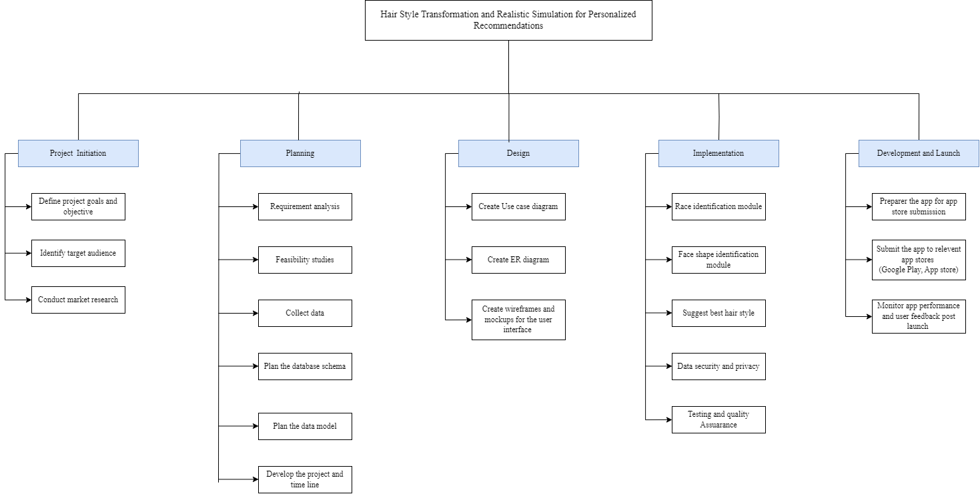
Work Breakdown Structure
IT21180798 | Vikasitha M.K.I. | 24-25J-155
8/10/2024

Slide 46

Commercialization
Target Audience :
Domestic Small-Scale Babar.
Mobile application is free for all users and when reach relevant download enable google adsense.

Slide 47
References
S. M. Garn, "Human Races: Myth or Reality?" American Anthropologist, vol. 65, no. 5, pp. 1302-1303, Oct. 1963, doi: 10.1525/aa.1963.65.5.02a00300. [1]
R. B. Lee, "Hairstyles as Cultural Indicators: A Study of Male Hairstyles among African-American Youth," Journal of Black Studies, vol. 28, no. 3, pp. 359-374, Jan. 1998, doi: 10.1177/002193479802800306 [2]
A. M. R. Rowden and S. Wright, "The Influence of Facial Shape on Hair Styling," International Journal of Cosmetology, vol. 14, no. 1, pp. 25-30, Mar. 2010, doi: 10.1002/ijc.2010.03.025. [3]
Hair modeling and simulation based on a single-view picture Binbin Zhou1) , Zhigeng Pan1), Mingmin Zhang2) （1Hangzhou Normal University, Hangzhou, 311121 ( 2Zhejiang University, Hangzhou, 310058) [4]
Integrated Multi-Model Face Shape and Eye Attributes Identification for Hair Style and Eyelashes Recommendation Theiab Alzahrani 1 , Waleed Al-Nuaimy 1,* and Baidaa Al-Bander 2 [5]
[pdf] A Hybrid Approach to Building Face Shape Classifier for Hairstyle Recommender System. [6]
Hairstyle Recommendation Based on Face Shape Using Image Processing. September 2018 Conference: 11th International Research Conference General Sir John Kotelawala Defence University At: Sri Lanka [7]
IT21180798 | Vikasitha M.K.I. | 24-25J-155
8/10/2024

Slide 48
Q & A
Proposal Presentation
24-25J-155
8/10/2024

Slide 49
Thank You!
Proposal Presentation
24-25J-155
8/10/2024

